Slide 2
Objectives
Describe how search engines work, and understand the search process
Use different types of search tools and compare search results
Apply search tool shortcuts and advanced features, including Boolean operators
Perform searches using browser search features
Identify and use specialized search tools
Identify online research alternatives to standard search tools

Slide 3
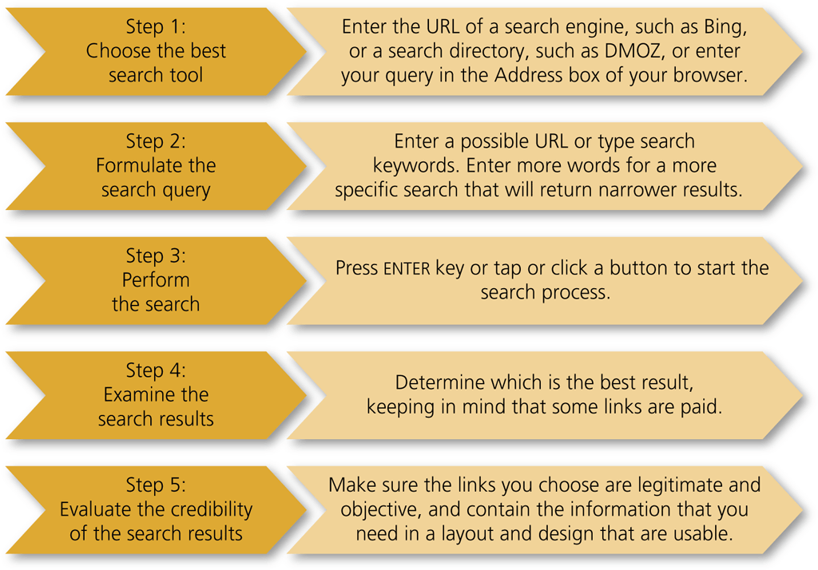
The Search Process
Choose the best search tool
Formulate the search query
Perform the search
Examine the search results
Evaluate the credibility of the search results

Slide 4
The Search Process
How Search Engines Work
  First few results are usually most relevant
  Search engine algorithms
  Crawlers
  Search engine optimization (SEO)
  Natural language searches

Slide 5
The Search Process
Search Engine Algorithms
  Personalized search
  Localized search
  Popular terms
  Trending content
  Natural language search

Slide 6
The Search Process
Choosing the Best Search Tool
  Easy to use
  Returns results quickly
  Provides access to frequently updated large indexes and other web-based files
  Presents most relevant search results returned
  Clearly indicates paid or sponsored links

Slide 7
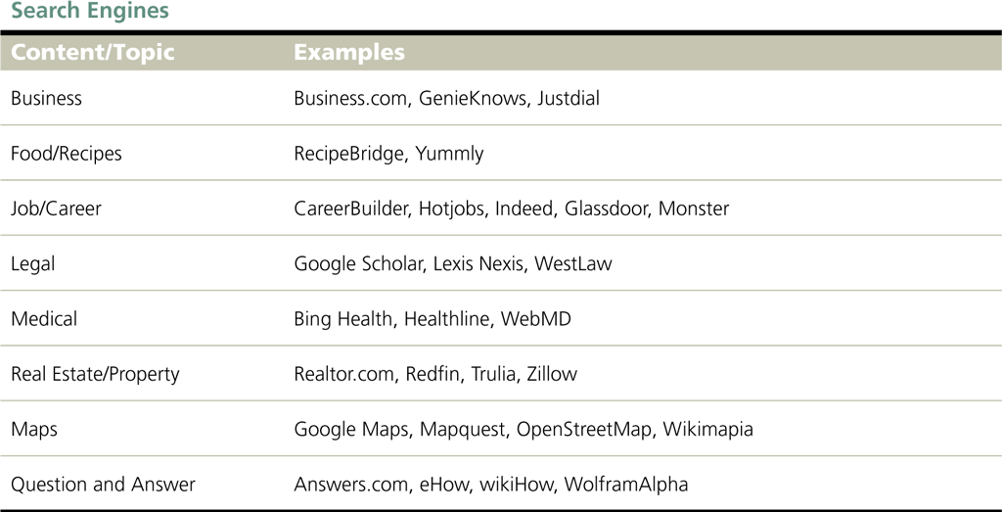
The Search Process

Slide 8
The Search Process
Formulating the Search Query
  The search query is the question that defines the information you seek
  A query should include at least one keyword, the specific word that describes that information
  Choose carefully, using specific rather than general keywords
  To perform a search, enter one or more keywords into the search text box or Address box
  A search tool then uses the keywords to identify relevant webpages and return a search results list

Slide 9
The Search Process
Formulating the Search Query (continued)
  A search tool then uses the keywords to identify relevant webpages and return a search results list
  Search results list contains the URL, title, and description of and links to webpages
  Each webpage item listed in search results list is a hit

Slide 10
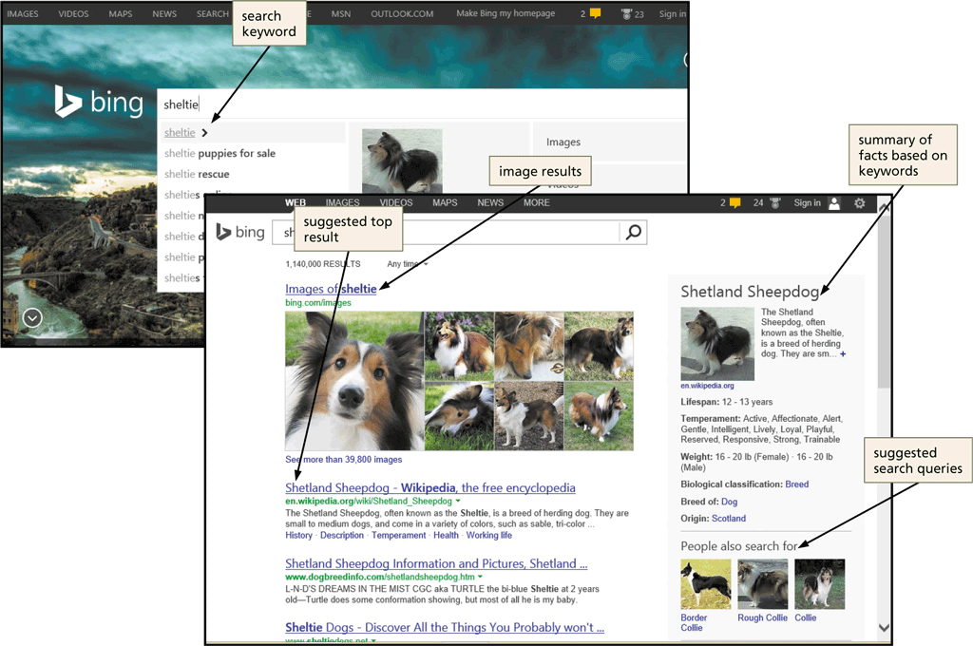
The Search Process
Formulating the Search Query (continued)
  More keywords equal more focused results
  Surround a phrase with quotation marks

Slide 11
The Search Process
Formulating the Search Query (continued)
  Ensure proper spelling
  A targeted search seeks specific information using keyword combinations
  An open-ended search seeks information on a broader scale using a simple keyword
  A search that uses complete sentences is sometimes called a natural language search
  Small, unimportant words in a natural language search query are called stop words, and are usually ignored

Slide 12
The Search Process
Examining the Search Results
  Different search tools return different search results for the same keyword
  Be aware that paid or sponsored listing may appear at top of search results
  People typically look only at the first 10 or 20 hits; search again with different keywords or search tool, if necessary

Slide 13
The Search Process
Evaluating the Credibility of Search Results
  Authority
    Owner or author expertise
    Check top-level domains
    Primary source is any document, item, or other data that provides firsthand information about a topic
  Objectivity
    Fair
    Unbiased
    Not skewed toward commercial or political interests

Slide 14
The Search Process
Evaluating the Credibility of Search Results (continued)
  Scope and Quality
    Depth of coverage
    Amount of detail provided
    Accurate and up-do-date
    Compares favorably with other pages on the same topic
    Consider currency for breaking news
  Design and Functionality
    Well-designed and easy-to-use page
    Broken links indicate poor attention to detail

Slide 15
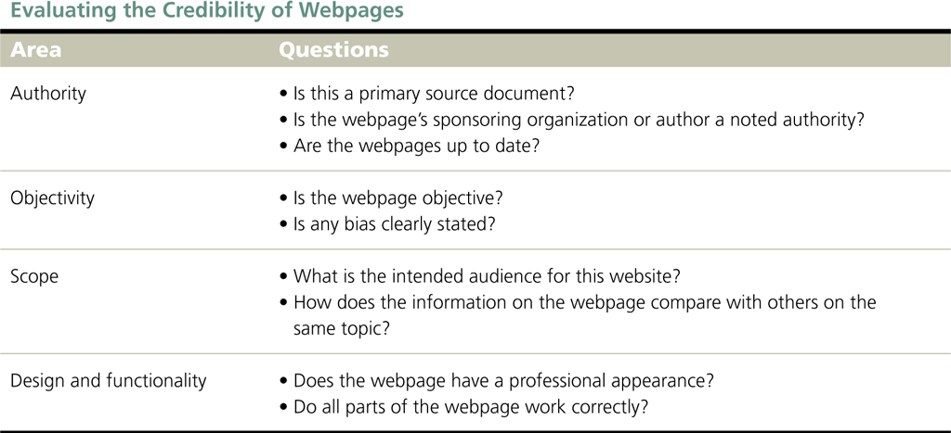
The Search Process

Slide 16
Search Tools
Directories
  Directory is a human-compiled, hierarchical list of webpages
  Yahoo! is one of the first directories
  Editors create an index, or list of webpages
  Organizes links in categories and subcategories
  Users increasingly drilling down through categories to find specific information
  A breadcrumb trail shows the hierarchical arrangement of categories and subcategories through which you have clicked

Slide 17
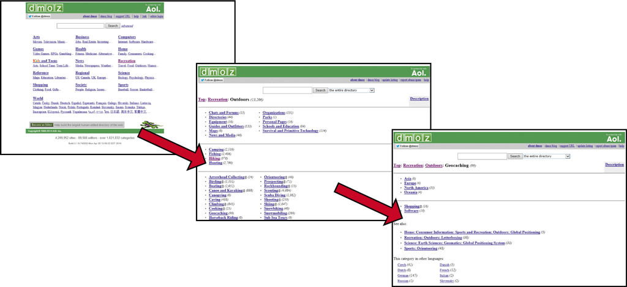
Search Tools

Slide 18
Search Tools
Search Engines
  Three major components are spider, bot, and web crawler
  Typical information collected by a web crawler
    Page title
    URL
    Meta tag keywords
    Occurrence of keywords in page
    All of the words on the page – full-text searching
    Internal links
    Number and relevancy of other webpages that link to the page

Slide 19
Search Tools
Search Engines (continued)
  Search engines use different algorithms to determine relevance of webpages in the search results
  Most search engines also include paid or sponsored listings on the search results page
  Many search tools today have become hybrids, basing results on indexes created by both web crawlers and human editors

Slide 20
Using Search Engines
Start a browser and enter the search engine in the Address bar
Enter the keyword search in the search text box and then tap or click the Search button to view the search results page

Slide 21
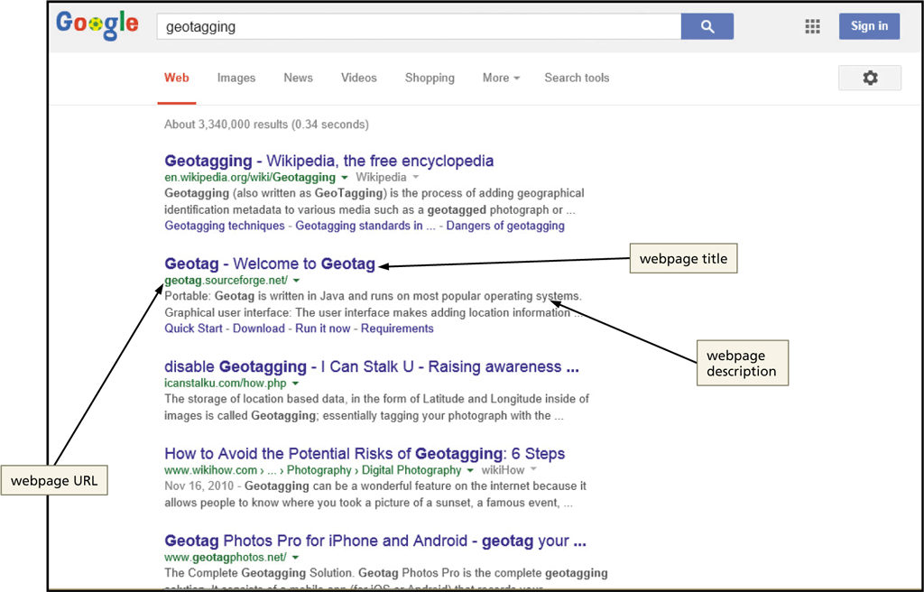
Using Search Engines

Slide 22
Search Tools
Metasearch Engines
  A metasearch engine compiles the search results from multiple search engines into a single search results list
    Some eliminate duplicates
    Watch for paid or sponsored listings in search results list
      Dogpile
      Mamma.com
      Zoo
      Ixquick

Slide 23
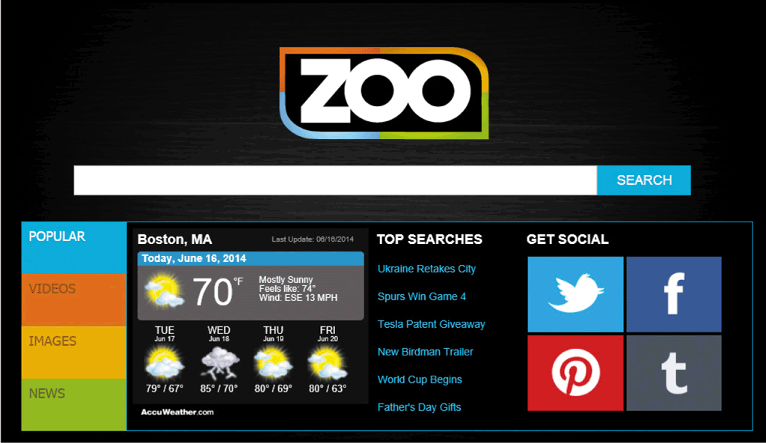
Search Tools

Slide 24
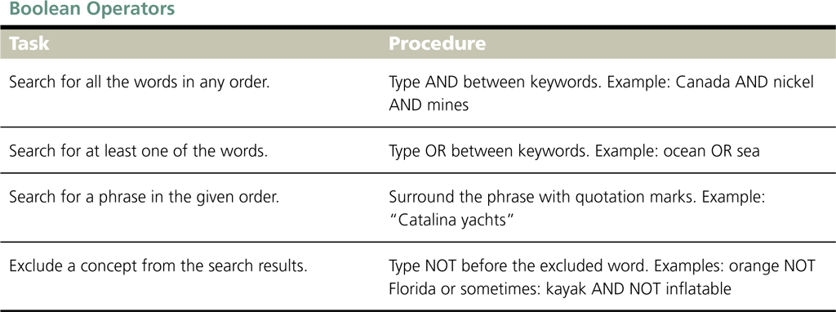
Advanced Search Techniques
Refining Searches
  A Boolean operator specifies which keywords should be included or excluded from search results

Slide 25
Advanced Search Techniques
Refining Searches
  Boolean operators include:
    AND
      Keyword must be included
    OR
      At least one of multiple keywords must be included
    NOT
      Keyword must be excluded
  Major search engines offer searching shortcuts

Slide 26
Advanced Search Techniques
Advanced Search Forms
  Used to structure complex search queries
  Prompts you to specify Boolean operators and other criteria
  Can filter results by:
    Language
    File type
    Domain
  Great way to learn more about how to use specific search engine shortcuts and Boolean operators

Slide 27
Browser Searches
Address Bar Searches
  Enter keywords in the Address box on the Address bar
  Press ENTER key or tap or click appropriate button to open search results page in the current tab

Slide 28
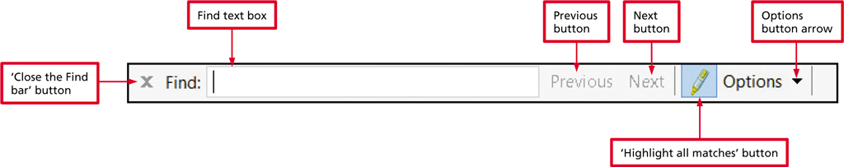
Browser Searches
Webpage Searches
  Find bar allows you to search the contents of a webpage
  Press CTRL+F to display the Find Bar

Slide 29
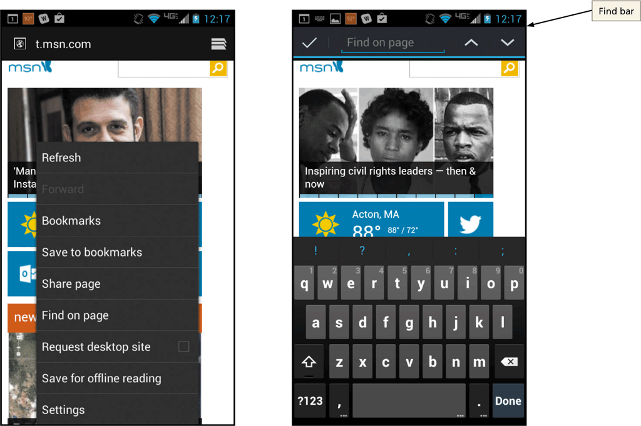
Browser Searches
Webpage Searches
  When using a mobile browser, tap or click ‘Find on page’ on browser menu to open Find bar

Slide 30
Browser Searches
Sorting and Filtering Search Results
  Most recent results
  Specify a timeframe for results pages
  Search for previously viewed webpages
  Search by reading level

Slide 31
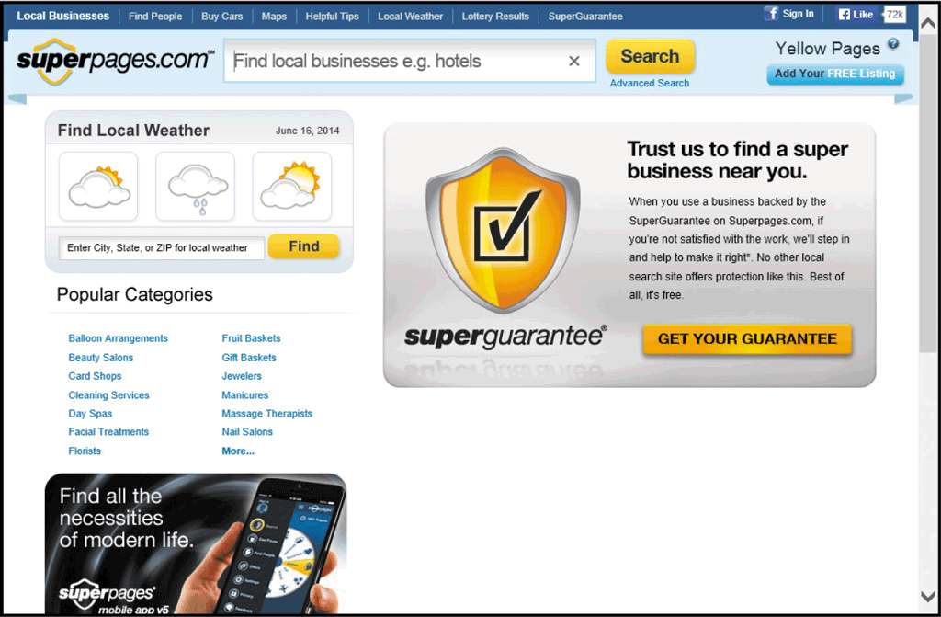
Specialized Searches
People and Business Search
  Use online white pages directory or online yellow pages directory

Slide 32
Specialized Searches
People and Business Search (continued)
  Free resources
    Pipl
    Wink
  Fee-based (pay for additional information)
    WhitePages
    Superpages

Slide 33
Specialized Searches
News and Current Event Search
  MSN
  Yahoo!
  Associated Press (AP)
  United Press International (UPI)
  Reuters

Slide 34
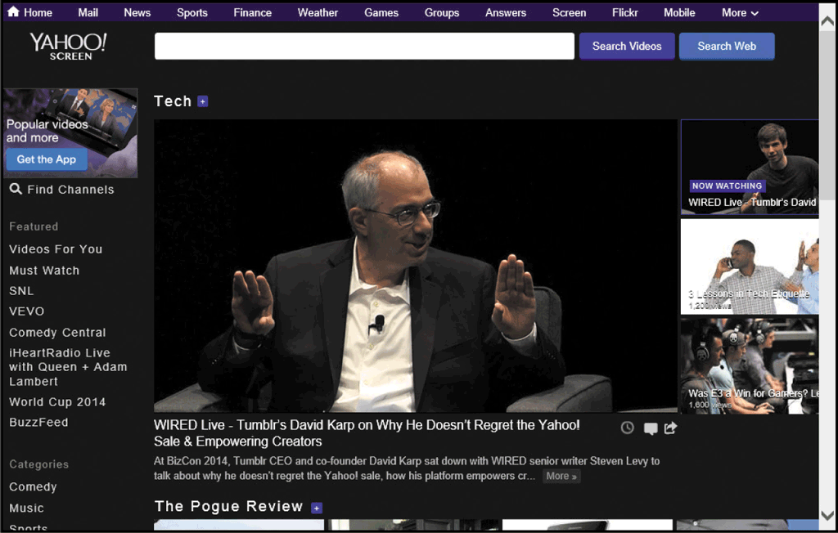
Specialized Searches
Video Search

Slide 35
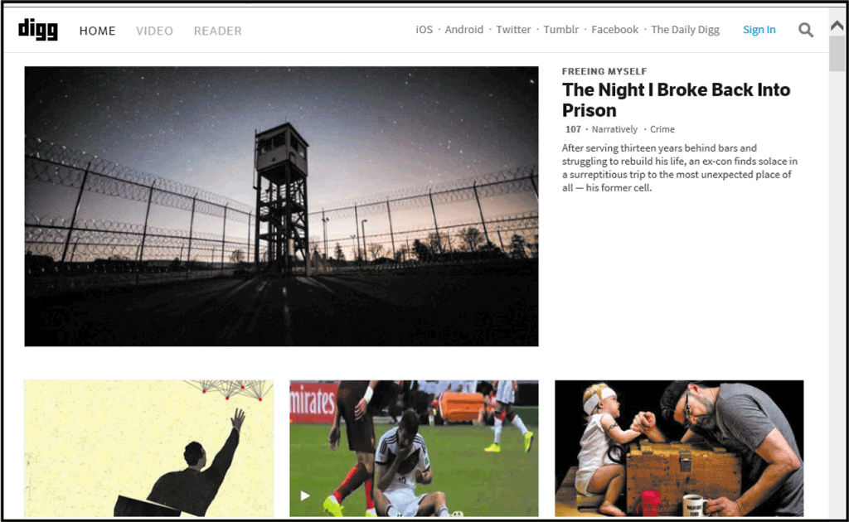
Specialized Searches
Social Media Search

Slide 36
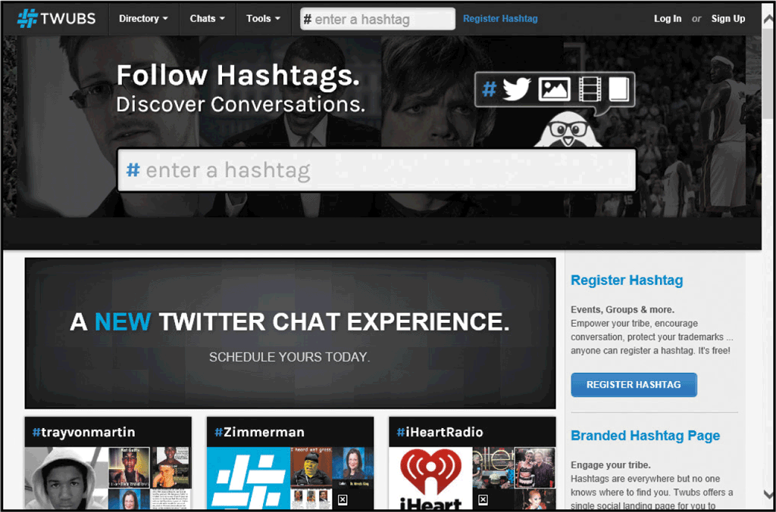
Specialized Searches
Hashtag Search
  A hastag is a word or phrase (with spaced removed), preceded by the # sign.
  Hashtags create
  a group of related
  Posts or media on
  a Specific platform
  such as Twitter

Slide 37

Specialized Searches
Shopping Search

